Slide 1
Suppliers Are Not Providing Value to Individual, Residential Customers
October 12, 2018
Presentation to the
New England Restructuring Roundtable
Rebecca Tepper, Chief
Energy and Telecommunications Division

Slide 2
Average Monthly Percentage of Households Purchasing from Competitive Suppliers, Electric Companies, and Municipal Aggregators

Slide 3
AGO Report
Do individual residential customers benefit?
NOT addressed:
  Commercial and industrial customers
  Municipal aggregation
Why?
  Leverage (in form of significant load)
  Knowledge of the market

Slide 4
$253 Million Lost
 | July 2015 – June 2016 | July 2016 – June 2017 | July 2017 – June 2018 | Three-Year Total Net Loss
Total Net Consumer Loss (millions) | $65.4 | $111.4 | $76.2 | $253

Slide 5
More Than a Few Bad Apples
Supplier ID | Average Rate | Number of Bills | Average Premium | Share of Accounts | Net Consumer Loss | Share of Loss
Supplier #37 | $0.1450 | 611,891 | $0.0546 | 10.35% | $20,571,677 | 18.47%
Supplier #41 | $0.1382 | 462,750 | $0.0484 | 7.83% | $12,970,332 | 11.64%
Supplier #32 | $0.1196 | 623,020 | $0.0290 | 10.54% | $12,035,815 | 10.81%
Supplier #12 | $0.1417 | 362,897 | $0.0511 | 6.14% | $8,763,432 | 7.87%
Supplier #42 | $0.1082 | 573,887 | $0.0170 | 9.71% | $6,429,872 | 5.77%
Supplier #6 | $0.1282 | 284,867 | $0.0381 | 4.82% | $6,237,222 | 5.60%
Supplier #15 | $0.1376 | 213,518 | $0.0458 | 3.61% | $4,648,970 | 4.17%
Supplier #18 | $0.1571 | 130,806 | $0.0657 | 2.21% | $4,443,744 | 3.99%
Supplier #23 | $0.1109 | 338,309 | $0.0203 | 5.72% | $3,778,146 | 3.39%
Supplier #47 | $0.1561 | 108,393 | $0.0657 | 1.83% | $3,751,646 | 3.37%
Total associated with Top 10 |  | 3,710,338 |  | 63% | $83,630,855 | 75%

Slide 6
Low-Income vs. Non Low-Income Participation
Low-Income Households Competitive Supply: 36%
Non Low-Income Households
Competitive Supply: 18%

Slide 7
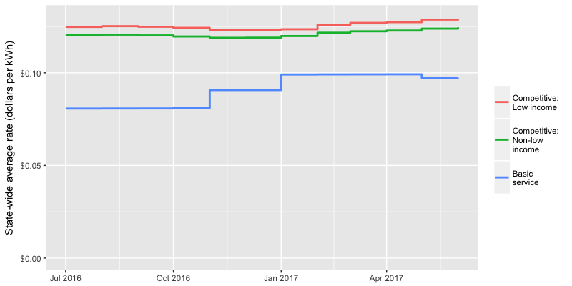
2016-17: Average Rates Charged by Suppliers vs. Average Basic Service Rates

Slide 8
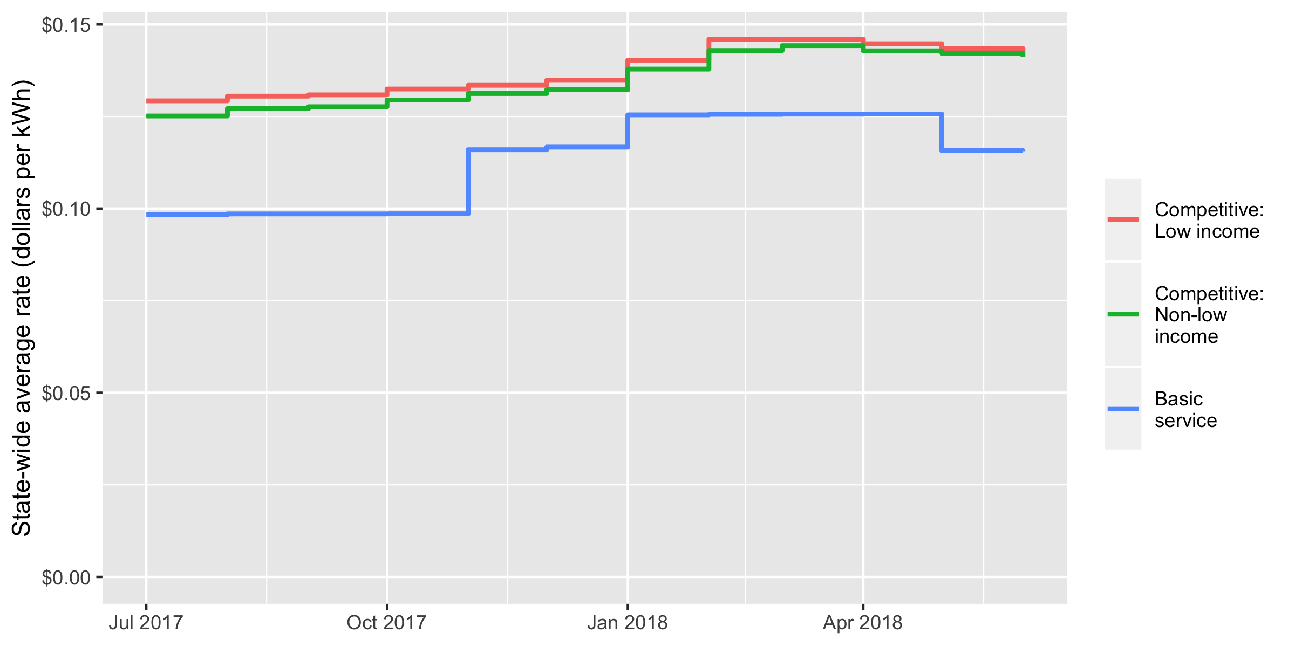
2017-18: Average Rates Charged by Suppliers vs. Average Basic Service Rates

Slide 9

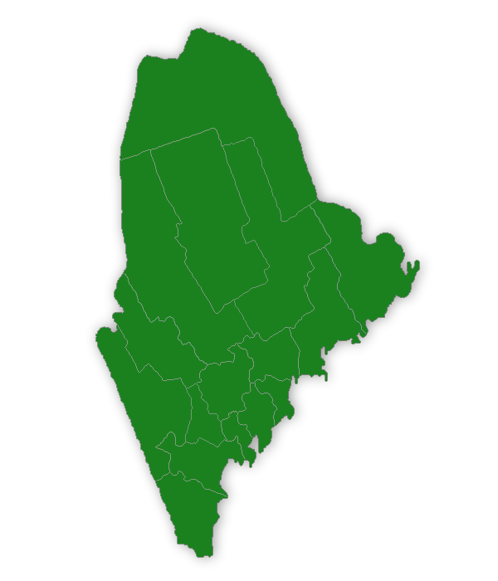


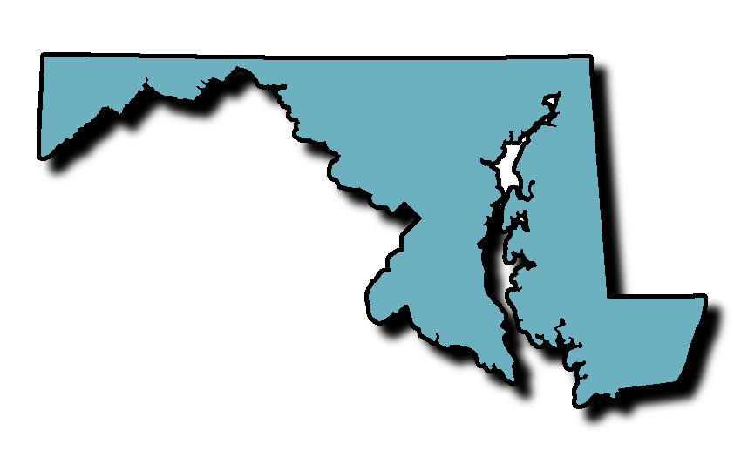


Other States Have Found Additional Regulation
Only Mitigates Consumer Harm
CT consumers lost $46 million even after banning variable rates and requiring rate disclosures

Slide 10
Potential Solutions Will Not
Prevent Consumer Harm
Prohibition on variable rates
  CT prohibited variable rates in 2016
Prohibition on charging low-income consumers more than basic service
  NY and PA have both implemented some form of this; CT is exploring implementation
Additional regulation and enforcement

Slide 11
Moving Forward
Prohibition on suppliers signing up new individual, residential customers
Impact on Restructuring
Response to Comments

